Slide 1
Regional characteristics of tropical expansion and the role of climate variability
Chris Lucas, Hanh Nguyen
Bureau of Meteorology – R&D Branch

Slide 2
Observations vs Models
Observed rate in many metrics is 0.5 – 1.0 degrees/decade of expansion. (e.g. Davis and Rosenlof 2012; Lucas et al 2014)
Rate expected in climate change projections (CMIP3, CMIP5) is typically 0.1-0.2 degrees per decade
Why? Several hypotheses…
  Model deficiencies – sensitivity too low, or simply incorrect
  Observational issues
    Short data sets (most from 1979)
    Reanalysis problems – inhomogeneities, poor constraint by observations
    Choice of metric – different metrics, different responses in some cases
Use Tropopause Height Frequency methods based on actual radiosonde data. No Reanalyses!

Slide 3
Data and methodology
Focus here is on using real observations (not reanalyses) to examine tropical expansion
  Basis for evaluation of reanalyses
Data used: Integrated Global Radiosonde Archive (IGRA) from NOAA
  Comprehensive global coverage, freely available from web
Methodology thoroughly described in Lucas et al (2012, JGR)
  Use all available data
  Create time/latitude array of tropical tropopause days (TTD) in ‘bands’
  ‘First difference’ compositing technique
  Sampling bias corrections, error estimation
  Contour time/latitude array to estimate trends, use TTD=300,200,100 and 50

Slide 4
Summary of Lucas et al (2012)
Analysis of SH expansion
3 regions (ANZ, AFR, SA) + average
  Focus on TTD=200 contour
Comparison with four reanalyses
  NCEP, NCEP2, ERA-40, ERA-I
  Same methodology applied
  Reanalysis contours shifted poleward
Trends (SH only)
sondes: 0.4 deg dec⁻¹ (expansion)
NCEP, NCEP2: 0.3 – 0.5 deg dec⁻¹
ERA-I: no trend
Two periods of notable difference
post-2002 -- better satellite observations improving ERA-I, creates inhomogeneity
pre-1985 – ??
Repeat this methodology for the NH, compare with SH results

Slide 5
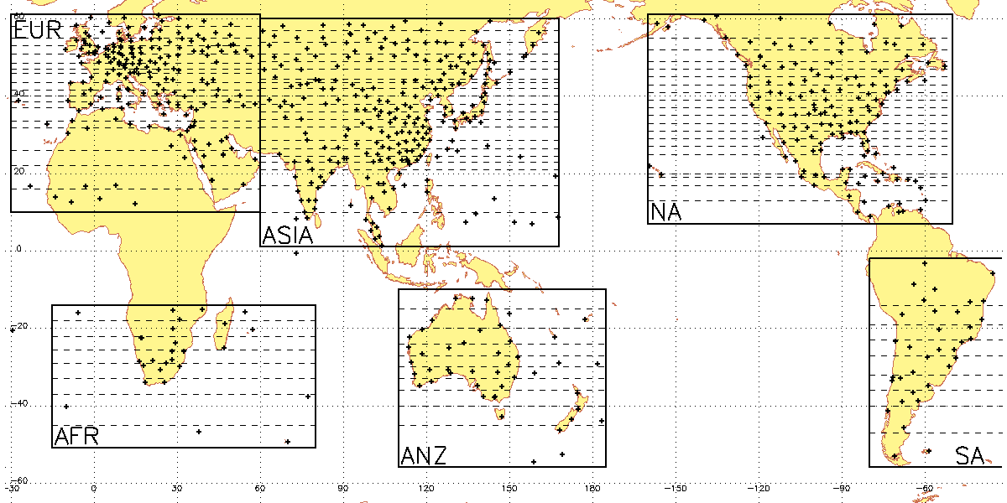
Study regions illustrated
Region Bands Sites
ANZ 10 45
AFR 8 26
SA 9 36
ASIA 21 252
EUR 19 178
NA 20 136

Slide 6
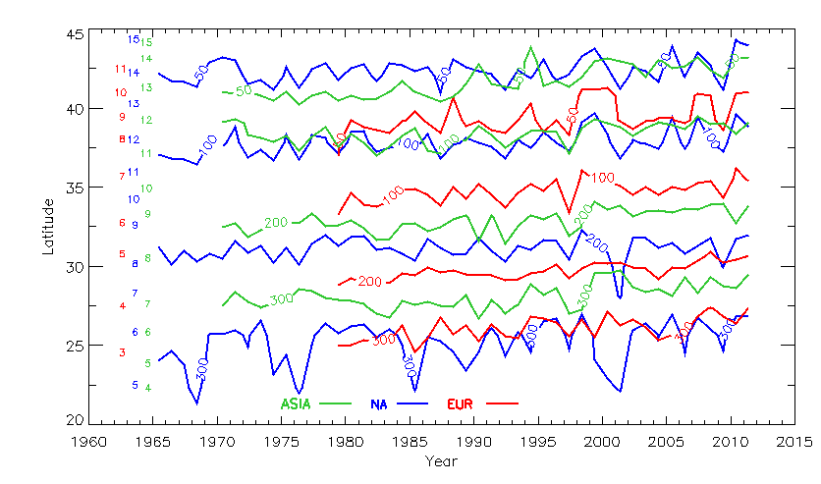
NH TTD contours by region
Structure of ‘subtropics’ different in the regions of the NH
  Less poleward extent in EUR
  300,200 contours shifted poleward in ASIA
  Thickest in NA
Significantly different variability in NA
  ‘Dips’ on 300 contour
  Responses around 2000
  Volcanic response?
Trends (since 1979)
  Largest in ASIA (0.5 - 0.8)
  Insignificant in NA (0-0.3)
  Moderate in EUR (0.4-0.5)
Numbers refer to band locations

Slide 7
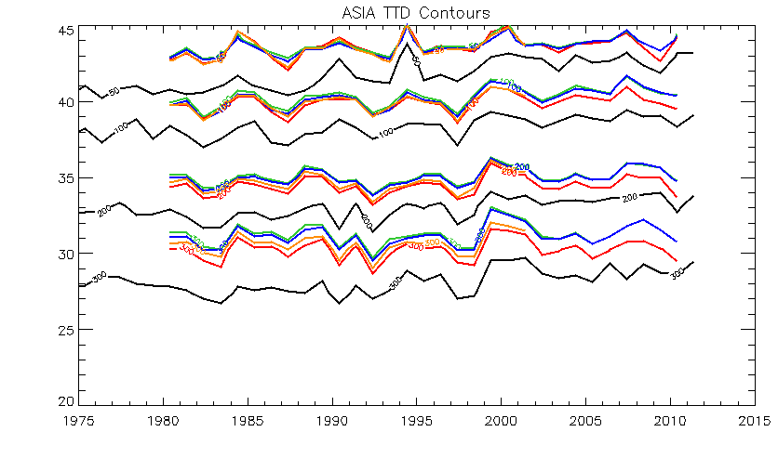
TTD contours from ASIA
Good match for interannual variability
General shift poleward of reanalysis contours
  1.5-3.0 degrees here
  Less in NA, EUR
Improvement in ERA-I shift (red lines) at end of period
50
100
200
300
black=sonde coloured=reanalysis

Slide 8
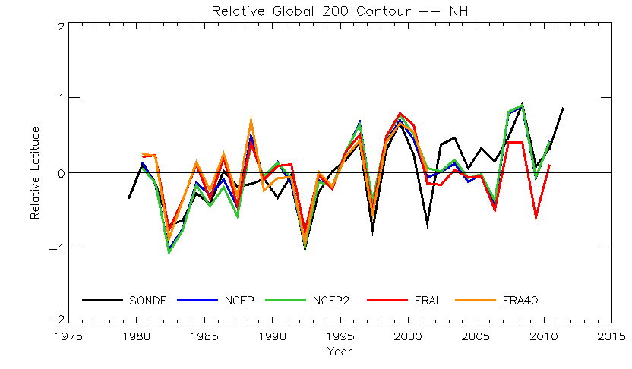
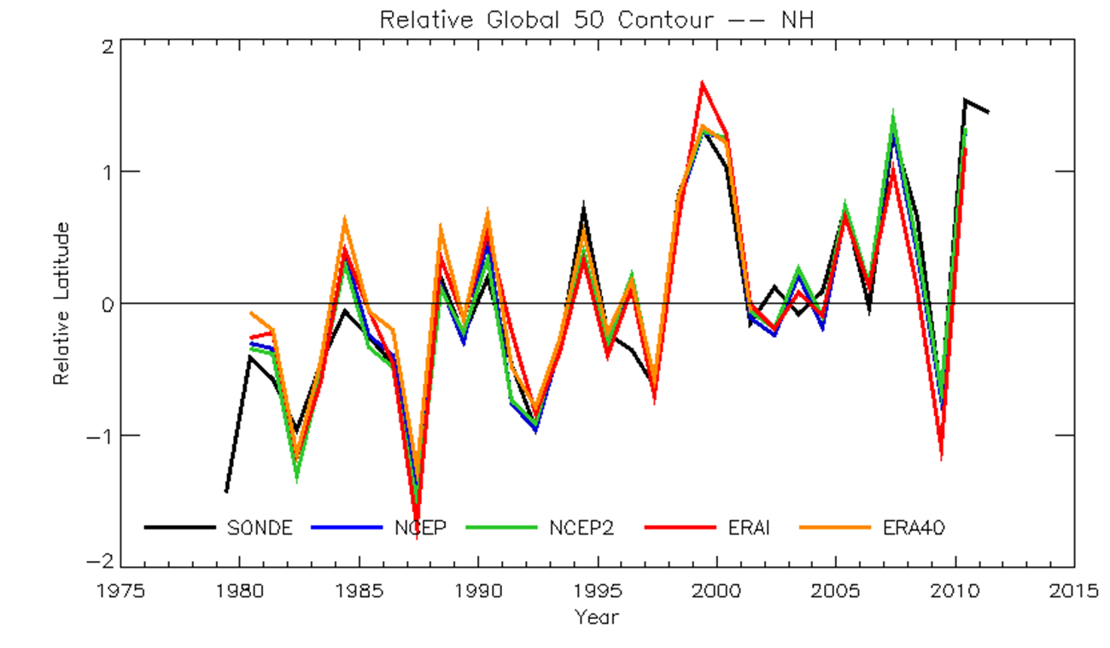
NH ‘global’ summary
Weighted average TTD=200 contour across all regions
  Removing mean position accounts for shift
  Volcanic response more visible in this view
Generally good agreement prior to 2002
  1987-88?
Significant differences occur after 2002, just as for SH
  Suggests inhomogeneity in reanalysis fields
  Hypothesis: related to significant improvement in satellite instrumentation (AIRS)
BUT…
There appears to be little sign of this poleward of 35 N…data match up very well there

Slide 9
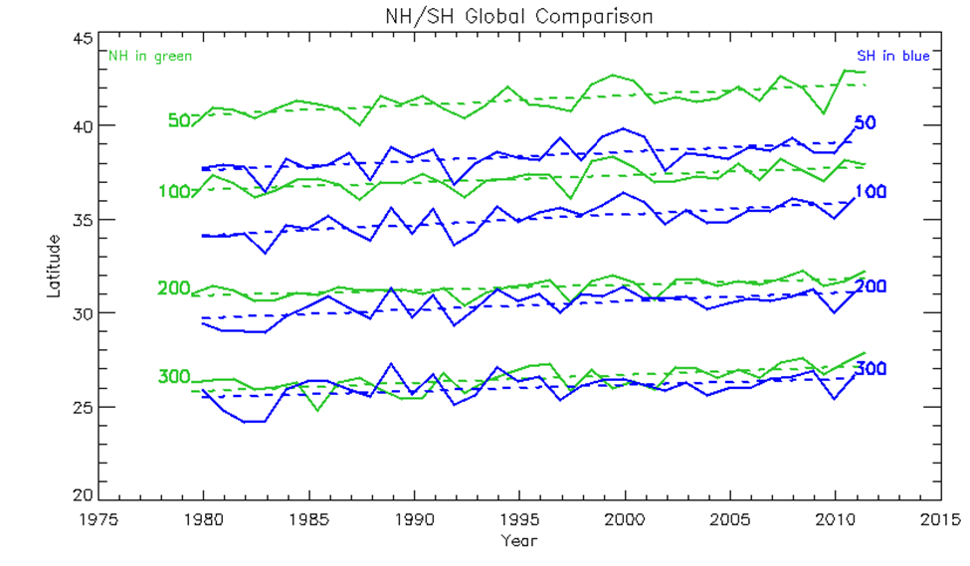
NH and SH Tropical Expansion
Contour | NH | SH
300 | 0.42 (0.20) | 0.32 (0.29)
200 | 0.29 (0.15) | 0.45 (0.23)
100 | 0.38 (0.20) | 0.57 (0.26)
50 | 0.52 (0.22) | 0.49 (0.38)
SH expansion greater than NH expansion, but difference not statistically significant

Slide 10
Partial Correlation and Regression
Examine role of natural climate variability in tropical expansion using partial correlation and regression techniques
  Isolate the effects of a single variable
Seven modes: ENSO, PDO, PNA, SAM, AO, NAO, AMO
Detrend all variables
  Only interannual effects captured
Relate annual global and regional TTD contours to annual and seasonal time series of mode time series

Slide 11
Results
ENSO matters almost everywhere
  Expansion during La Nina
  ‘Reverse’ effect in NA
  Regression mag: 0.2-0.5 deg/unit, more on ‘extratropical’
  JJA, SON
PDO mostly in ASIA and NH
  Shifts whole tropics toward north during negative phase
  Regression mag: 0.3-0.5 deg/unit
  All seasons but MAM
SAM strongly affects ANZ during MAM
  Weak general effects in SH
PNA, AMO show regional, specific interannual effects
AO, NAO results confusing, no strong effects noted

Slide 12
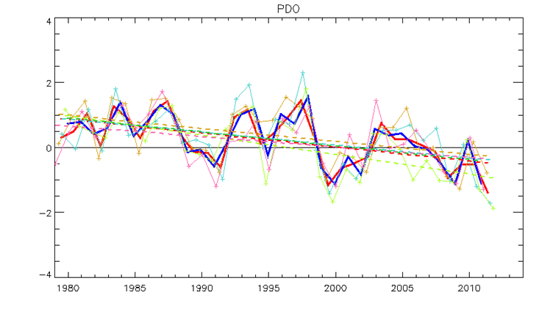
Estimating effect on TE trends
PDO Index
Previous effects were interannual only
Many mode indices have apparent trends over 1979-2012 period
  ENSO, PDO, SAM, AMO
Estimate number of units that index changes
Multiply by regression coefficient to get amount of change,
Divide by time to get average trend
1-1.5 units of change
1.5 units * 0.6 deg/unit = 0.9 deg
0.9 deg / 3.3 decades = 0.27 deg dec⁻¹
Up to 50% of observed trend

Slide 13
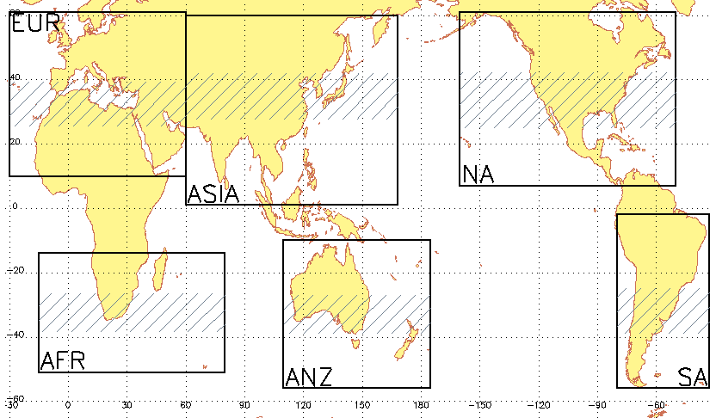
Regional Tropical Expansion and Climate Variability
0.1 - 0.5
0.5 - 0.8
0.2 - 0.3
PDO
up to 50%
*
Global: ENSO
10-30% (except *)
0.4 – 0.5
0.2 - 0.3
0.3 - 0.8
SAM
20-30%
*

Slide 14
Discussion
Regional variability/effects key to understanding impacts of TE, particularly in NH
Possible Mechanisms
  Interannual (e.g ENSO, SAM) – shifts in storm tracks, eddy jet → changes in baroclinic waves and shifts in tropical edge…eg. Chen and Held (2007), Chen et al (2008), Ceppi and Hartmann (2013)
  Decadal (e.g. PDO, AMO) – changes to SST patterns eg. Staten et al (2012), Quan et al (2014), anomalous heating/cooling of midlatitudes from SST pattern (eg. Allen et al 2012)
Apparent tropical expansion since 1979 has been enhanced by natural variability
  Climate models won’t necessarily capture this variability.
  What happens when modes shift (e.g. PDO, ‘end’ of ozone hole)?

Slide 15
Thank you.
Your name
Your details

Slide 16
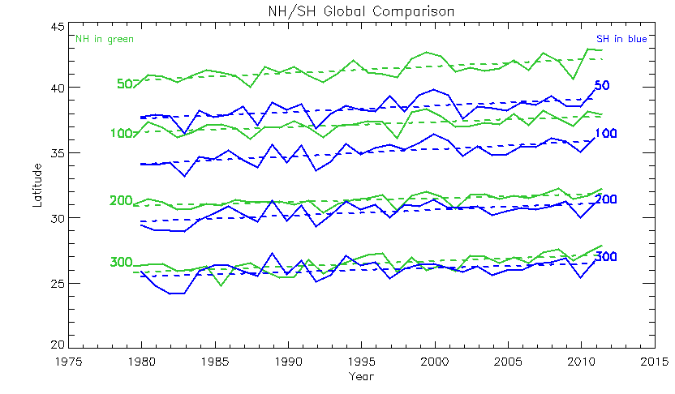
NH/SH ‘global’ comparison
Subtropics in NH are larger compared to SH
  Start in same place, but extend further poleward
  Likely related to greater land are in NH
  Analogous to finding with other variables (e.g. Ψ)
Is tropical expansion asymmetric?
  Trends in SH on 300,100, 50 less reliable (data issues)
  SH trends are larger on 200,100 contours, but not statistically significantly so (about 1-σ difference)
Notes:
NH SH
trend 2sig trend 2sig
300 0.420462 0.201095 0.319531 0.293714
200 0.291574 0.148492 0.449804 0.230418
100 0.382005 0.202238 0.568014 0.258521
50 0.522106 0.222866 0.490054 0.283335
Units are degrees per decade

Slide 17
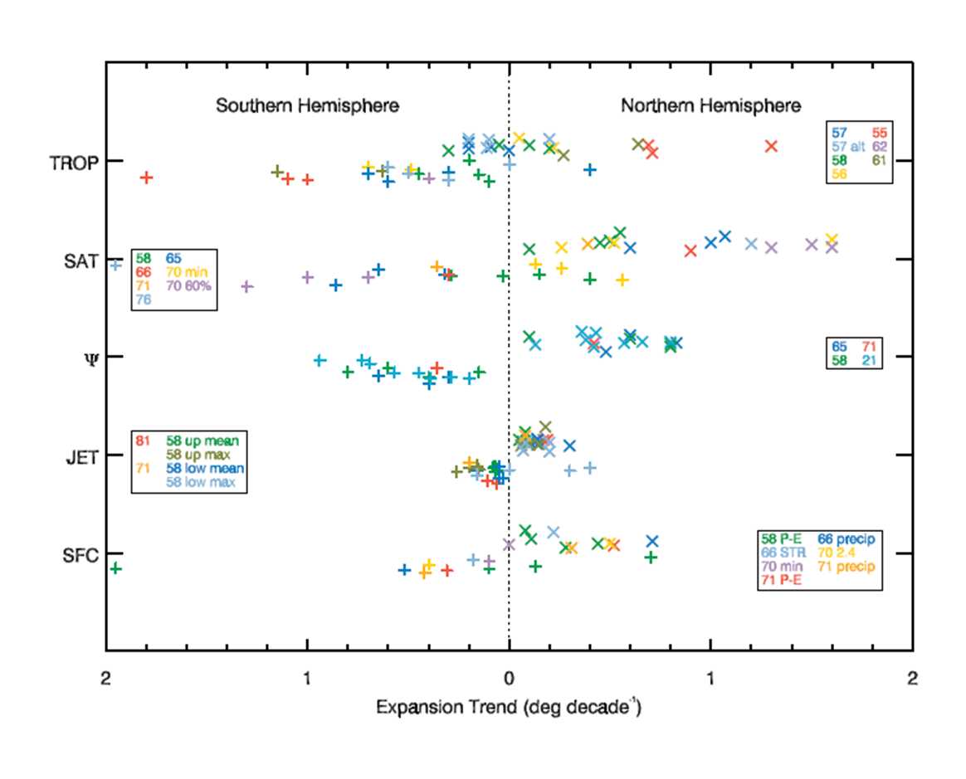
Observations of Tropical Expansion
Tropical Expansion is real
Observed across multiple datasets and a variety of metrics
Consensus of observations suggests an expansion rate of 0.5-1.0 degrees/decade from 1979
Expansion is observed in both hemispheres
From Lucas et al. (2014)

Slide 19
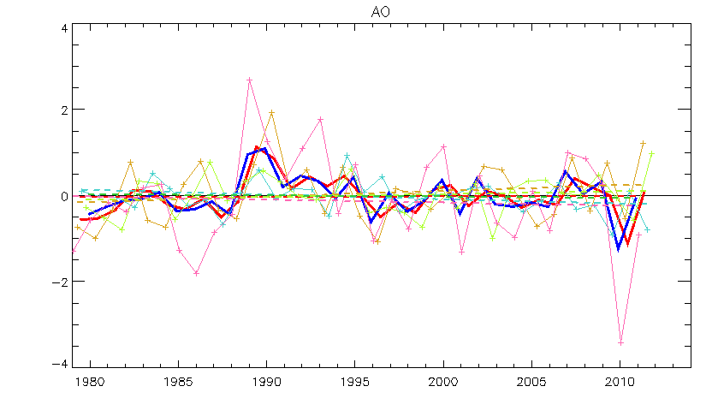
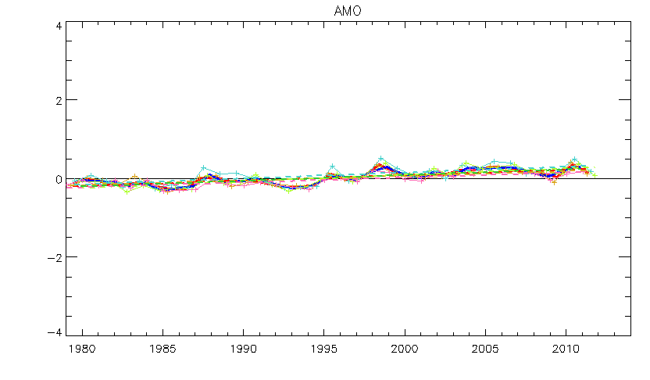
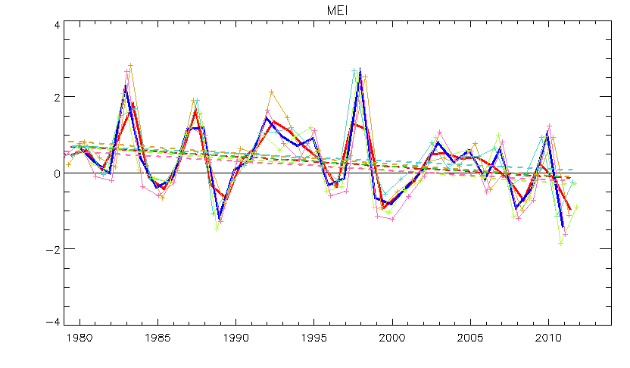
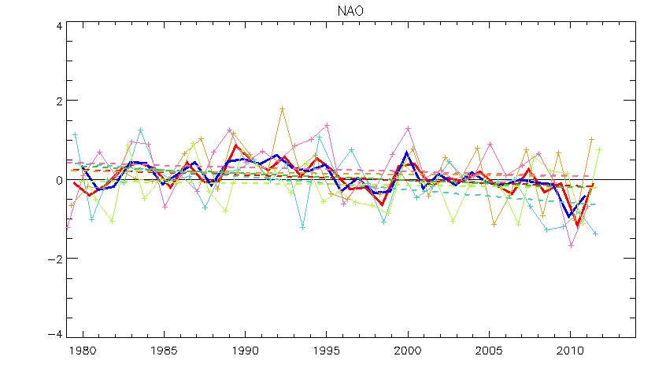

Slide 20
