Slide 1
Understanding the causes of
SH tropical expansion
Chris Lucas, Hanh Nguyen, Bertrand Timbal
Bureau of Meteorology – R&D Branch

Slide 2
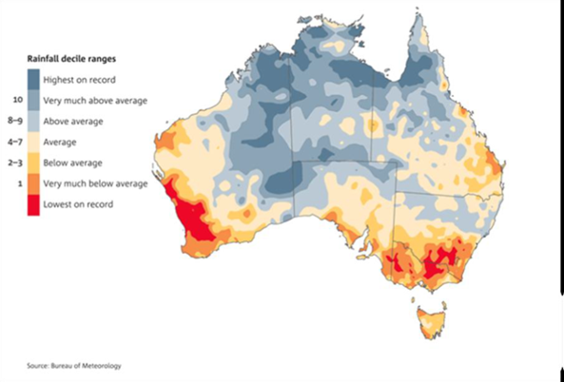
Motivation
Why do we care about tropical expansion?
SWWA rainfall decline (from 1970s)
SE Aust Millennium drought (1997-2009)
1997-2013 Apr-Sept rainfall deciles
Impacts
  Water resources
  Agriculture
  Fire weather
  Politics
Is this sign of tropical expansion? Global changes to MMC impacting locally?
State-based ‘climate initiatives’ (e.g IOCI, SEACI, VicCI) to understand causes, make projections and help agencies manage resources

Slide 3
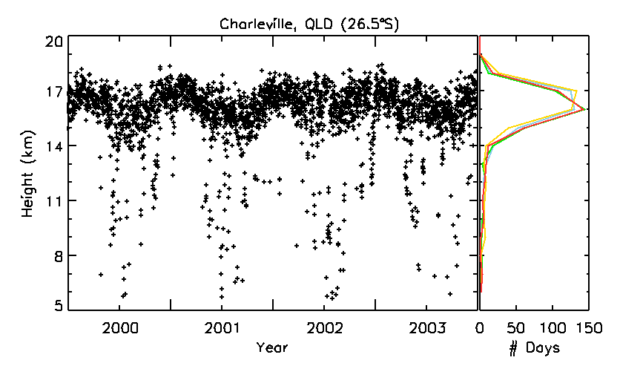
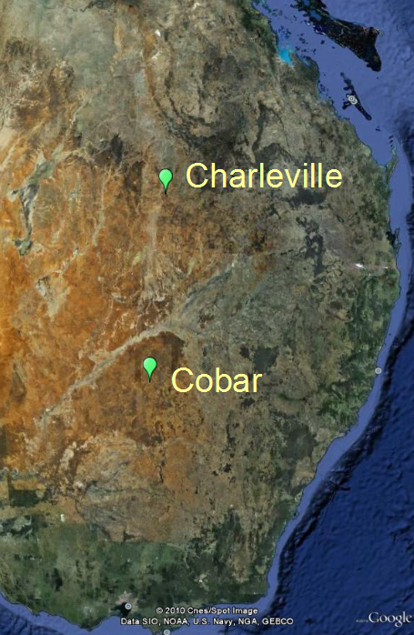
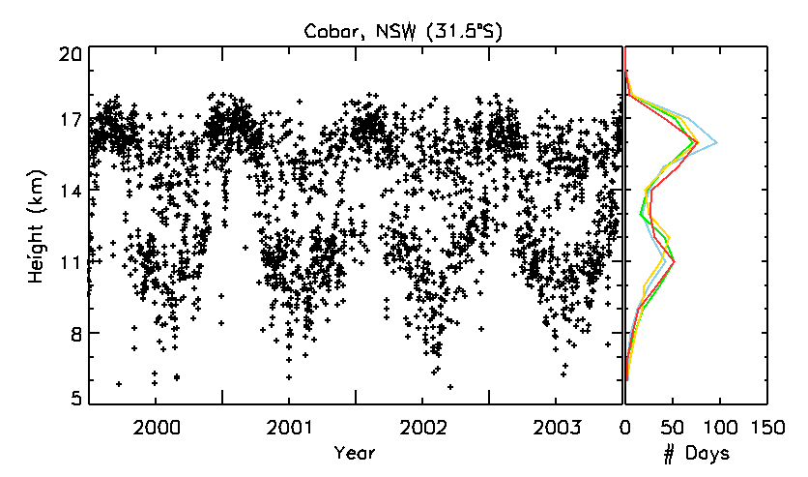
Tropopause Height Frequency method
Use tropopause statistics to determine 'edge of tropics'
Tropical Tropopause Day (TTD) = day where tropopause > 14.5 km
Create time/latitude array of the annual number of TTD
Contour array at 50,100, 200, 300 days. Slope of contour equals expansion rate
See Lucas et al (2012) for full details of method
No systematic variation with threshold choices in sonde data

Slide 4
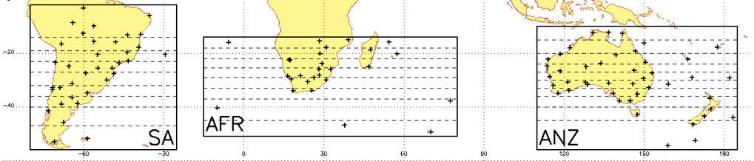
Summary of Lucas et al (2012)
Analysis of SH expansion
3 regions (ANZ, AFR, SA) + average
  Focus on TTD=200 contour
Comparison with four reanalyses
  NCEP, NCEP2, ERA-40, ERA-I
  Reanalysis contours shifted poleward
Trends
sondes: 0.4 deg dec⁻¹ (expansion)
NCEP, NCEP2: 0.3 – 0.5 deg dec⁻¹
ERA-I: no trend
Two periods of notable difference
post-2002 -- better satellite observations improving ERA-I, creates inhomogeneity
pre-1985 – ??

Slide 5
Factors behind tropical expansion
Modes of climate variability explain some portion of the trends and help resolve the uncertainty between models and observations
What are some other proposed factors behind tropical expansion?
  Greenhouse Gas (GHG) – C-C relation, change in static stability lead to weakening of HC (e.g. Held and Soden 2006)
  Stratospheric Ozone Depletion – many studies suggest this is sole/main driver in SH (e.g. Polvani et al (2011); McLandress et al. (2011); Min and Son (2013)), particularly in DJF
  Aerosol + tropospheric ozone – particularly for NH tropical expansion. See Allen et al (2012) and Allen et al. (2014)…
  Natural forcing – Volcanoes in particular can act to contract the tropics over the short term

Slide 6
Attribution Approach -- Observations
Focus is on the SH
Use multiple linear regression on global average 200-day TTD contour
  Proxy variables
    Stratospheric Optical Depth (volcanic forcing) – Sato et al (1993)
    Multivariate ENSO Index (MEI) (Wolter and Timlin 1998)
    Global (or SH) temperature anomaly (GHG and aerosol) -- Hansen et al (2010)
    Ozone Hole Area (ozone) from http://ozonewatch.gsfc.nasa.gov/
  To account for cross-correlation, variable are adjusted by removing linear effects
Two versions of regression are performed using either the global or SH temperature series

Slide 7
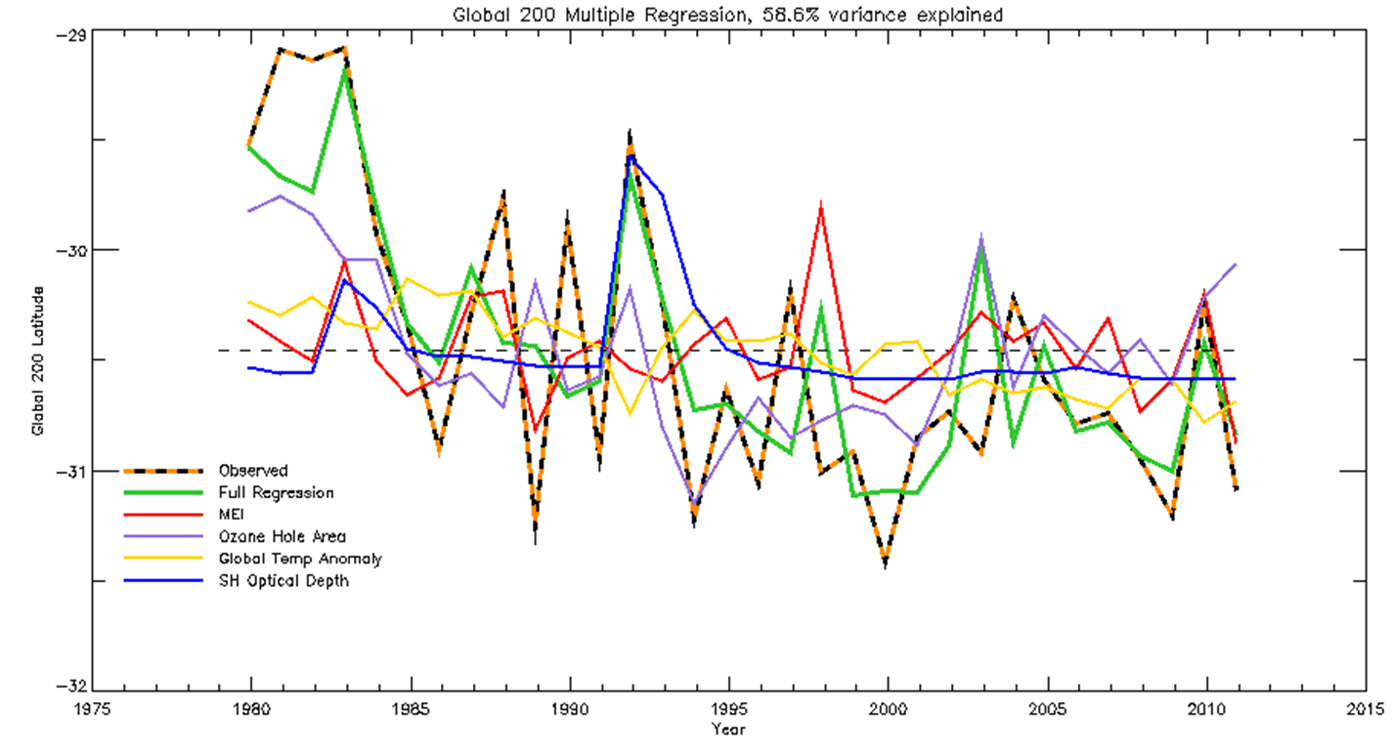
Observational results
Regression captures 58.7 - 59.4 % of variance
Each regression produces trend of 0.37 degrees/decade
RMS error of fit is 0.4 degrees
About 30% of the trend is due to natural factors (10% MEI, 20% volcanoes)
Remaining 70% is due to anthropogenic factors
  10-40% is related to temperature
  60-30% is related to ozone hole area
First number is SH temperature

Slide 8
Attribution Approach -- Simulation
Simulations with the Community Climate System Model 4 (CCSM4) using the historical scenarios are analysed between 1960 and 2005.
Five forcing ‘single forcing‘ scenarios are examined: ALL (all forcings), NAT (volcanoes and solar), O3 (ozone only), GHG (greenhouse gas only) and AER (anthropogenic aerosol only). Three-member ensembles are used for each scenario.
The tropospheric height frequency methodology is adapted for use with the monthly model output. The 200-day TTD contour is used as with the observations
Trends on the 200-day TTD contour are examined over the whole period and from 1979.

Slide 9
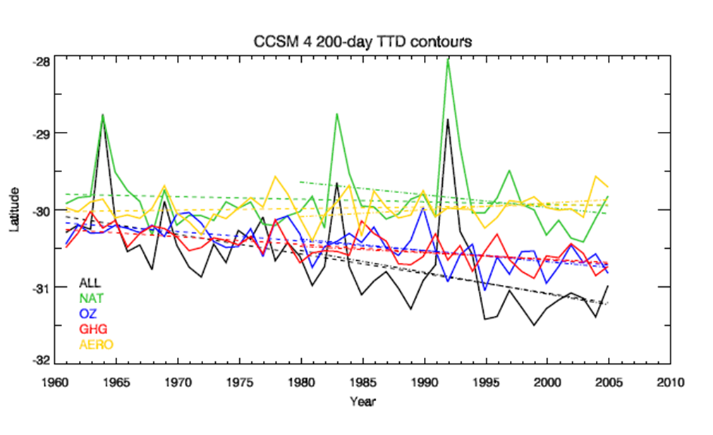
Simulation Results
Run | 1960-2005 Trend | 1979-2005 Trend
ALL | -0.25 (0.14) | -0.28 (0.40)
NAT | -0.03 (0.12) | -0.16 (0.31)
O3 | -0.12 (0.05) | -0.15 (0.12)
GHG | -0.10 (0.04) | -0.08 (0.11)
AER | +0.02 (0.05) | +0.09 (0.11)
From 1960
O3 and GHG are dominant
NAT and AER have small trends
From 1979
NAT accounts for ~40% of expansion
O3 also accounts for ~40%
GHG is about half that
AER acts to contract the tropics

Slide 10
Attribution Synthesis
Observational and modelling results broadly agree on the partition of forcing factors of SH tropical expansion.
Combining results, the best estimate is that since 1979, the partition of forcing factors is: 30% resulting from natural factors (volcanoes and ENSO), 40% resulting from stratospheric ozone depletion and 30% resulting from increasing greenhouse gases, with an error range roughly estimated at ± 5%.
The large role of natural factors is largely the result of the choice of starting point of the analysis.
The role of aerosol remains unclear, but the CCSM4 simulations suggest that it is unimportant for SH tropical expansion

Slide 11
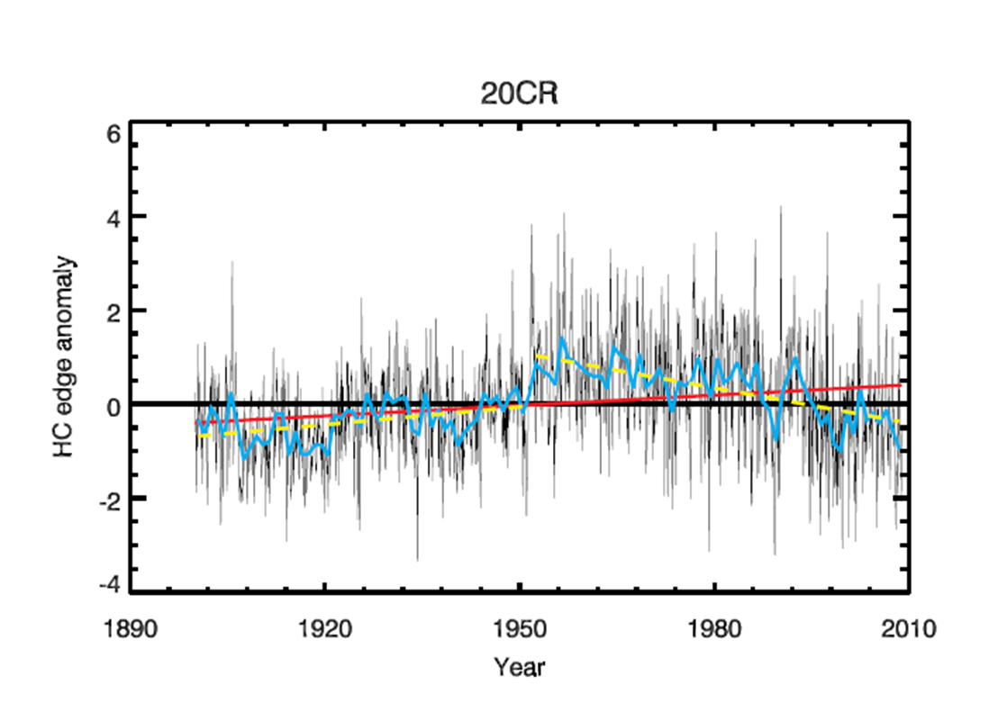
Long term evolution of HC
SH data from 20CR reliable from 1952
Detectable tropical expansion since 1950s-60s
Significant ozone depletion only since early 1980s
Understanding the longer history of tropical expansion is crucial!
Hadley Cell edge Ψ method

Slide 12
Thank you.
Chris Lucas
c.lucas@bom.gov.au

Slide 13
OLR estimates
Time-latitude plot of annual zonal-mean OLR
250 W m⁻² used to define edge
Get trend from temporal variation of edge
Expansion trends: 0.82 in NH, -0.32 in SH
Data are composite of many satellites
Satellites ‘drift’, changing time the scene is viewed
Equatorial crossing time (ECT) bias, especially over land areas
ECT-bias needs to be removed
Sapiano et al [2010] dataset
NH edge
subtropics
SH edge
satellite change times
Zero trend in uncorrected version!! More consistent with expectations

Slide 14
Tropopause Height Frequency
Annual frequency of subtropical tropopause height is bimodal
Tropical – peak at 15-16 km
Extratropical – peak at 12-13 km
Estimate edge from number of tropical tropopause days (TTD)
focus on TTD=200 contour
computed from 1979-2011 using IGRA radiosondes and 4 reanalyses
Trends (SH only)
sondes: 0.4 deg dec⁻¹ (expansion)
NCEP, NCEP2: 0.3 – 0.5 deg dec⁻¹
ERA-I: no trend
See Lucas et al [2012] in JGR
Two periods of notable difference
post-2002 -- better satellite observations improving ERA-I, creates inhomogeneity
pre-1985 – ??

Slide 15
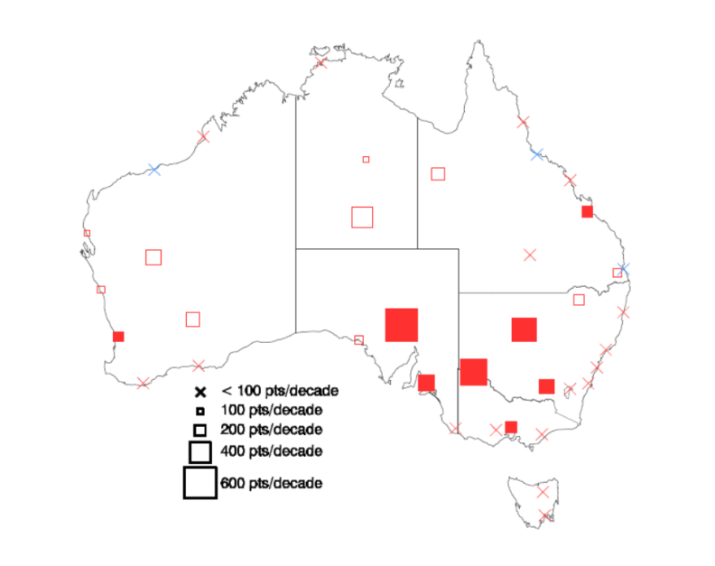

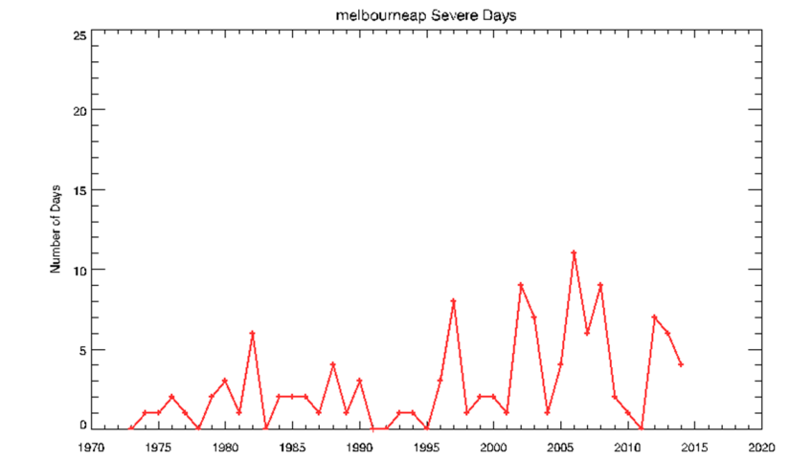
1997-2013 Apr-Sept rainfall deciles

