Slide 1
Regional impacts of Hadley Circulation expansion in the Southern Hemisphere
Hanh Nguyen, Harry Hendon, Eun-Pa Lim, Chris Lucas, Eric Maloney, Bertrand Timbal
BOM – R&D

Slide 2
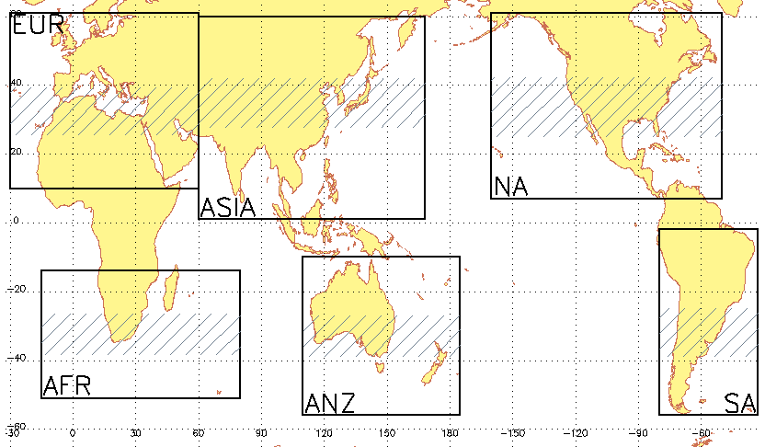
Regional Tropical Expansion and Climate Variability
0.1 - 0.5
0.5 - 0.8
0.2 - 0.3
0.4 – 0.5
0.2 - 0.3
0.3 - 0.8

Slide 3
Motivations
How to quantify regional contribution to the zonal mean Hadley circulation expansion?
Identify regional impacts of Hadley Circulation expansion.
Mechanism behind Hadley Circulation expansion?

Slide 4
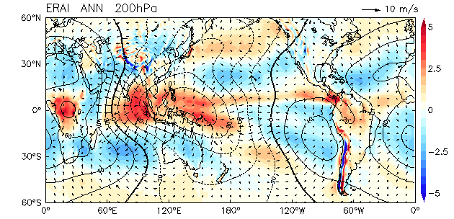
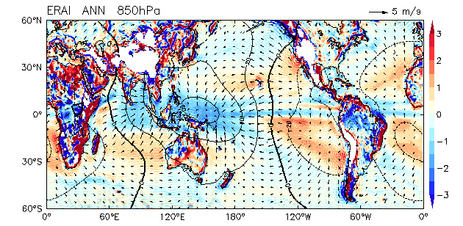
Three centers of action
Europe-Africa (EA = 25ºW-60ºE)
Asia-Pacific (AP = 60ºE-175ºW)
Americas (AA = 175ºW-25ºW)
Shading: divergence
Contours: velocity potential
Vectors: divergent winds

Slide 5
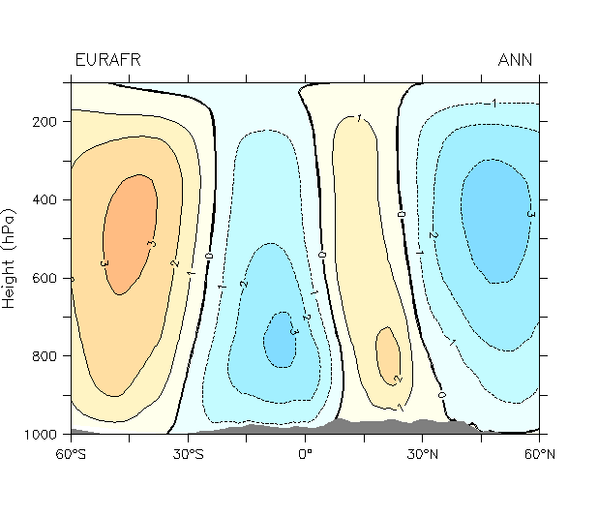
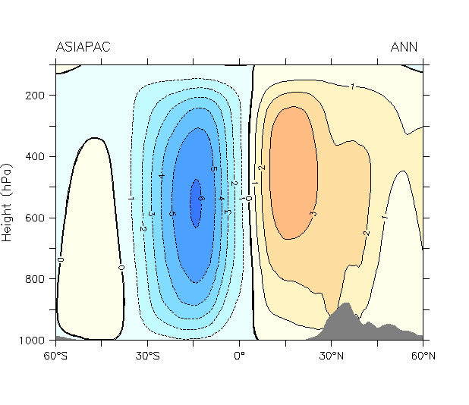
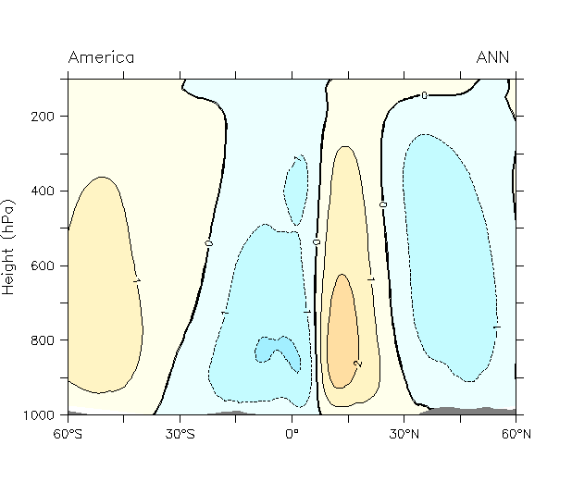
Regional Hadley Circulations (annual mean)
Eurpe-Africa
Asia-Pacific
Americas
Marked regional variability in the Hadley Circulation: strongest and widest over Asia-Pacific.

Slide 6
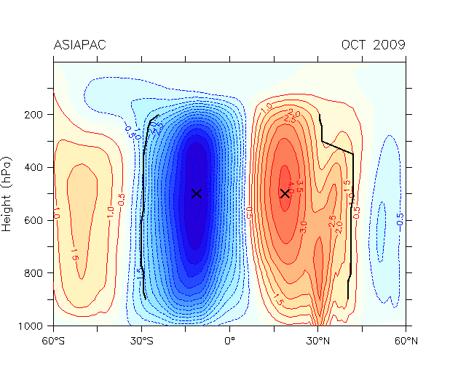
Definition of the HC edges
HC edge defined as the poleward location of the near-zero value of the overturning streamfunction (=25% of the peak value) averaged between 700-400 hPa.

Slide 7
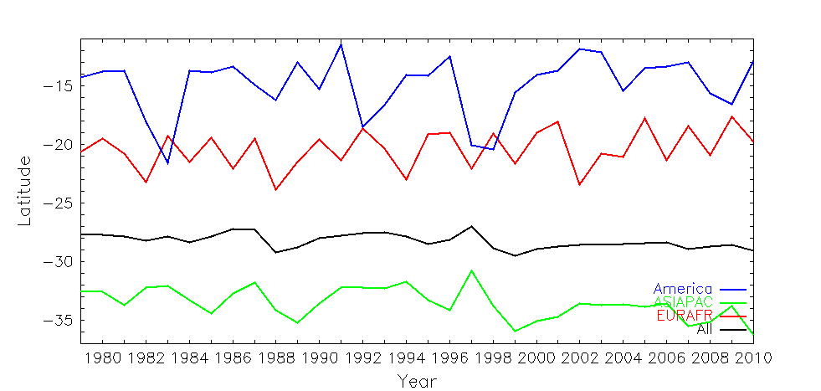
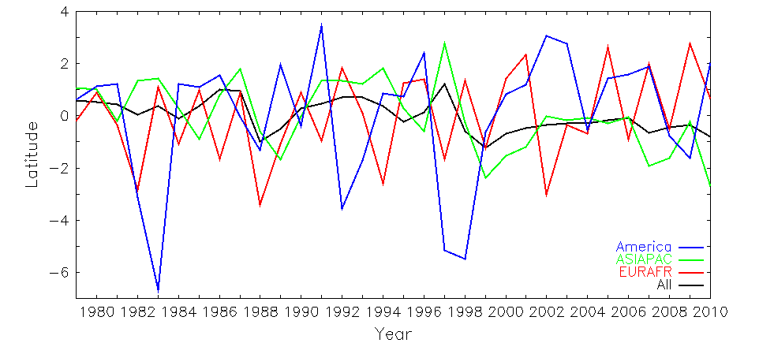
Annual mean time series of the HC edges
Southern Hemisphere Europe-Africa Asia-Pacific Americas
mean
anomalies
The longitudinally weighted average of three regional edges loosely follows the hemispheric edge.
Marked regional variability of the HC edge.
Variability in the Asia-Pacific resembles the most to the hemispheric HC edge.

Slide 8
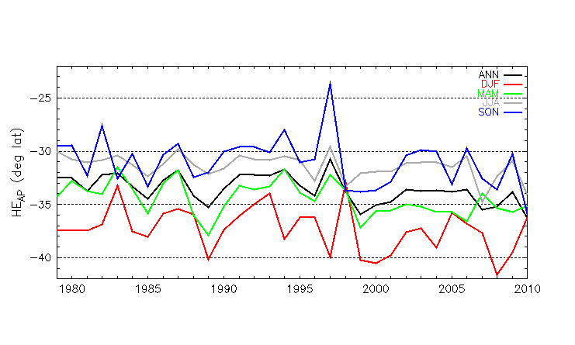
Seasonal mean evolution of the HC edge for the Asia-Pacific sector
Annual DJF MAM JJA SON
Season | Trend
ANN | 0.71***
DJF | 0.67*
MAM | 0.71**
JJA | 0.53**
SON | 0.69

Slide 9
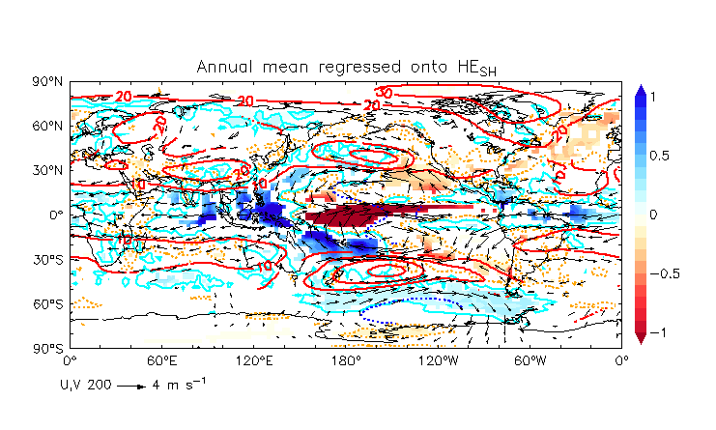
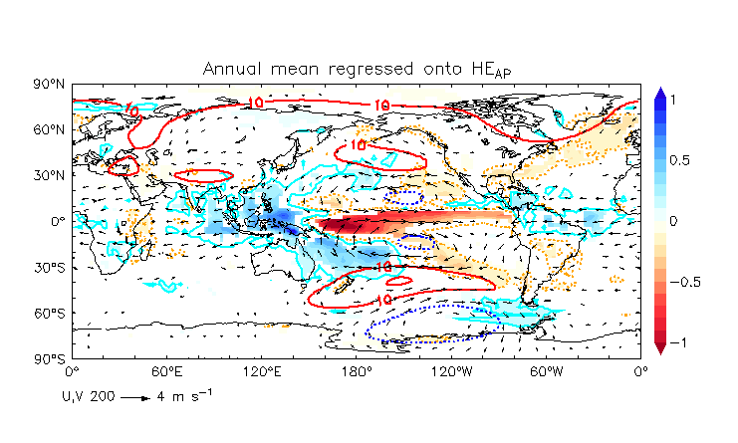
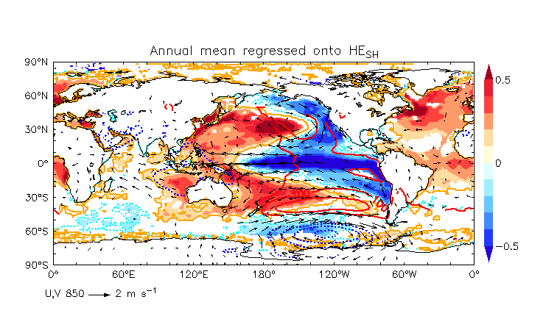
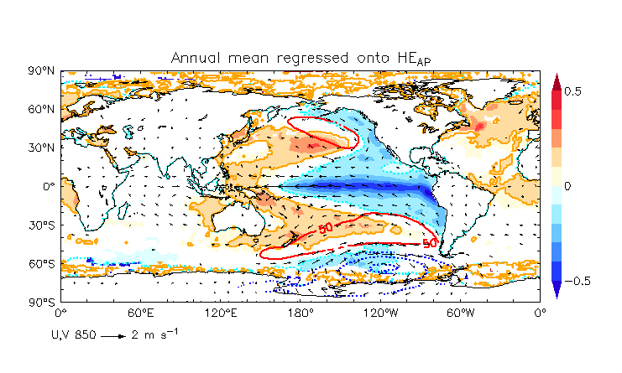
Circulation anomalies regressed onto annual mean HC edge
upper level (200hPa)
Shading: SST contours: geopotentical height vectors: winds
lower level (850hPa)
Shading: precipitation contours: MSLP vectors: winds
Southern hemisphere
Asia-Pacific

Slide 10
Circulation anomalies regressed onto Asia-Pacific annual mean HC edge
upper level (200hPa)
Shading: SST
contours: geopotentical height
vectors: winds
lower level (850hPa)
Shading: precipitation
contours: MSLP
vectors: winds

Slide 11
Conclusion
Local Hadley circulation defined using divergent winds.
The southern hemisphere HC is dominated by the behavior of the HC in the Asia-Pacific sector: most of HC expansion over the hemisphere occurs in the Asia-Pacific (where the tropical convective heat source is largest).
SST La Niña conditions to drive the HC expansion which may explain why models have underestimated the expansion in the historical period (ensemble mean models do not depict this La Niña condition or swing to cold IPO).
Next step: separate long term trends and inrerannual variability

Slide 12
Thank you.
Chris Lucas
C.Lucas@bom.gov.au

Slide 13
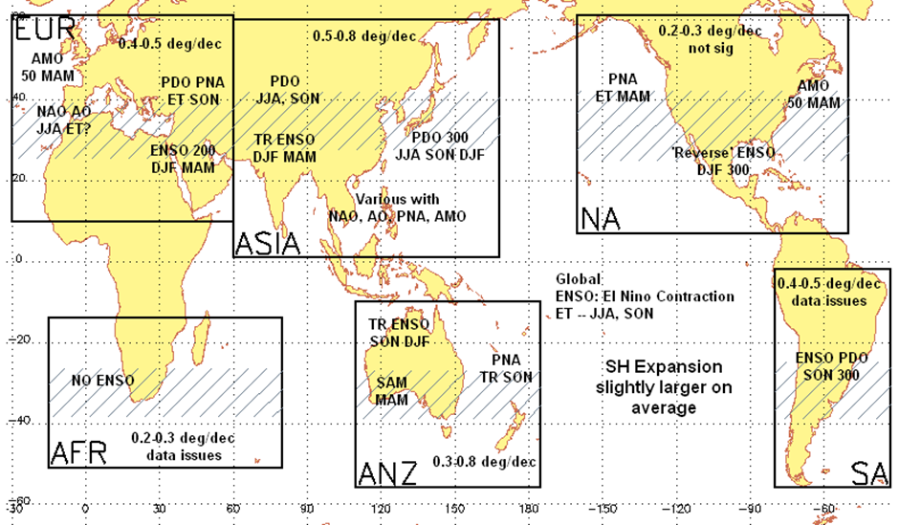
Tropical expansion inferred from radiosondes

